Slide 1
Data-driven Air Cargo
Louis Mai, 13 Sep 2024

Slide 2
Proposed CHAMP’s Machine Learning System
Dataset
Save good features
Expected output
Search for relevant features
Revenue, demand, etc
Train Machine Learning model
Deploy Machine Learning model

Slide 3
CHAMP’s Market Predictor
Time-series features
Insight & Prediction:
Demand forecast
Revenue
Long-term price prediction
Machine Learning model
Frequency & Date-related features
Macroeconomic features

Slide 4
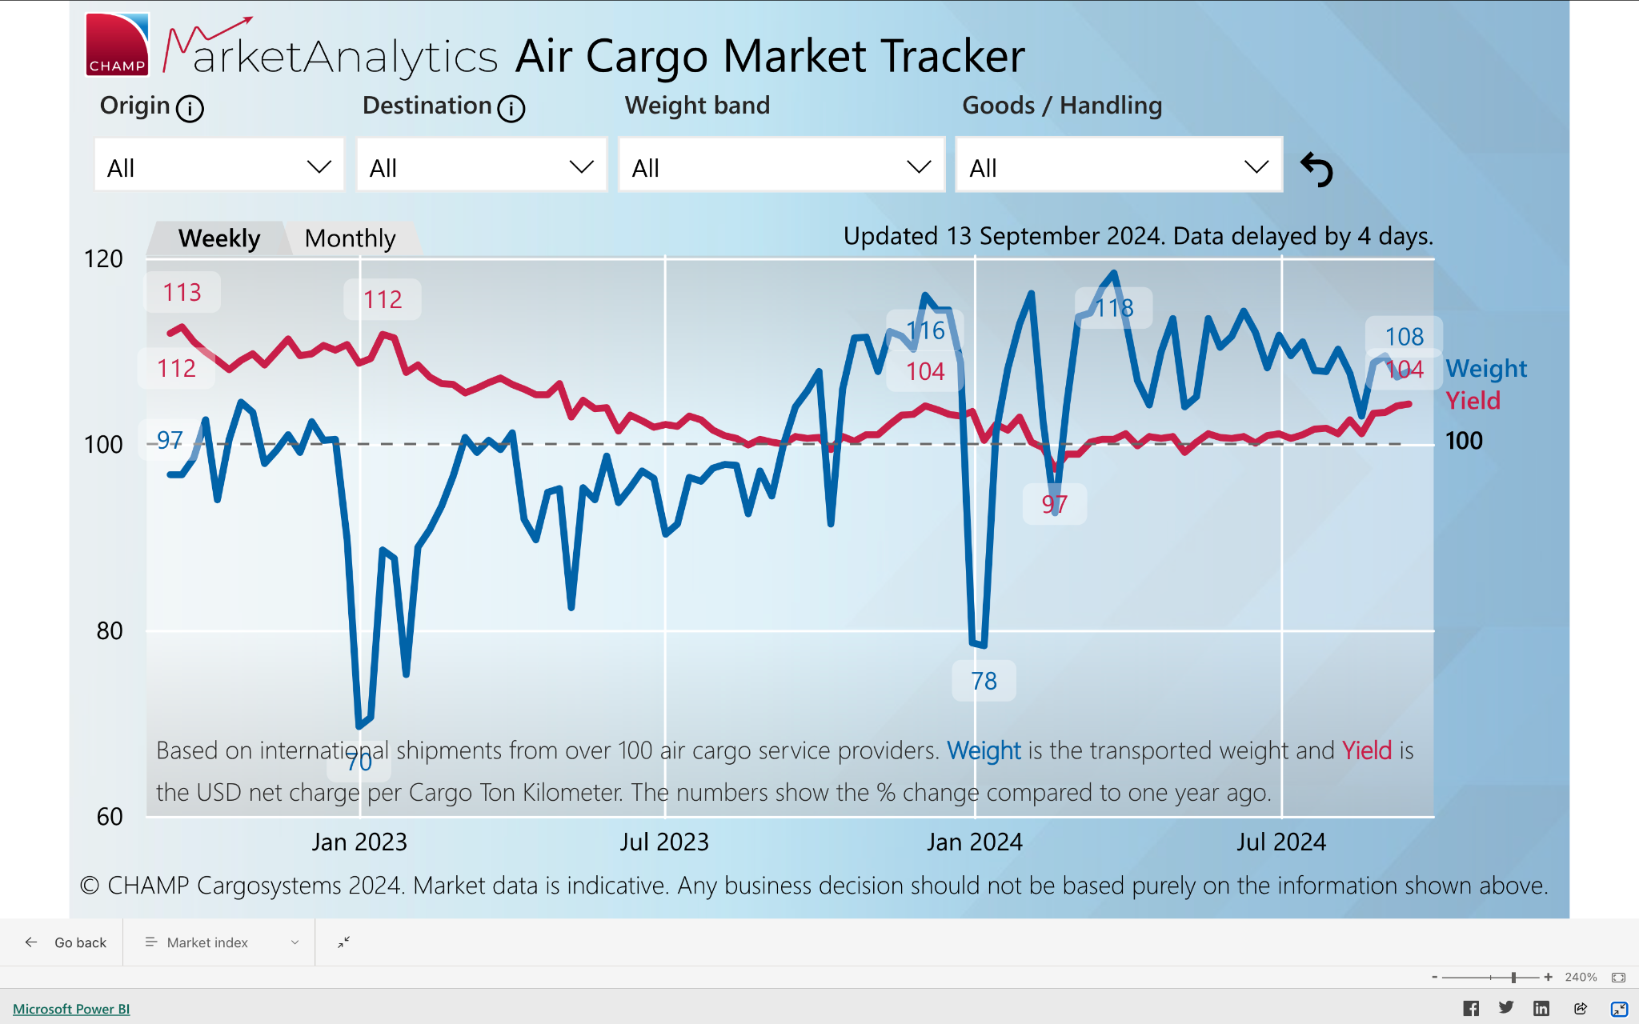
Use Case: Forecast Air Cargo Weight
Screenshot of CHAMP’s MarketAnalytics.
Source: https://www.champ.aero/products/champ-insights/champ-marketanalytics, retrieved 13Sep2024.

Slide 5
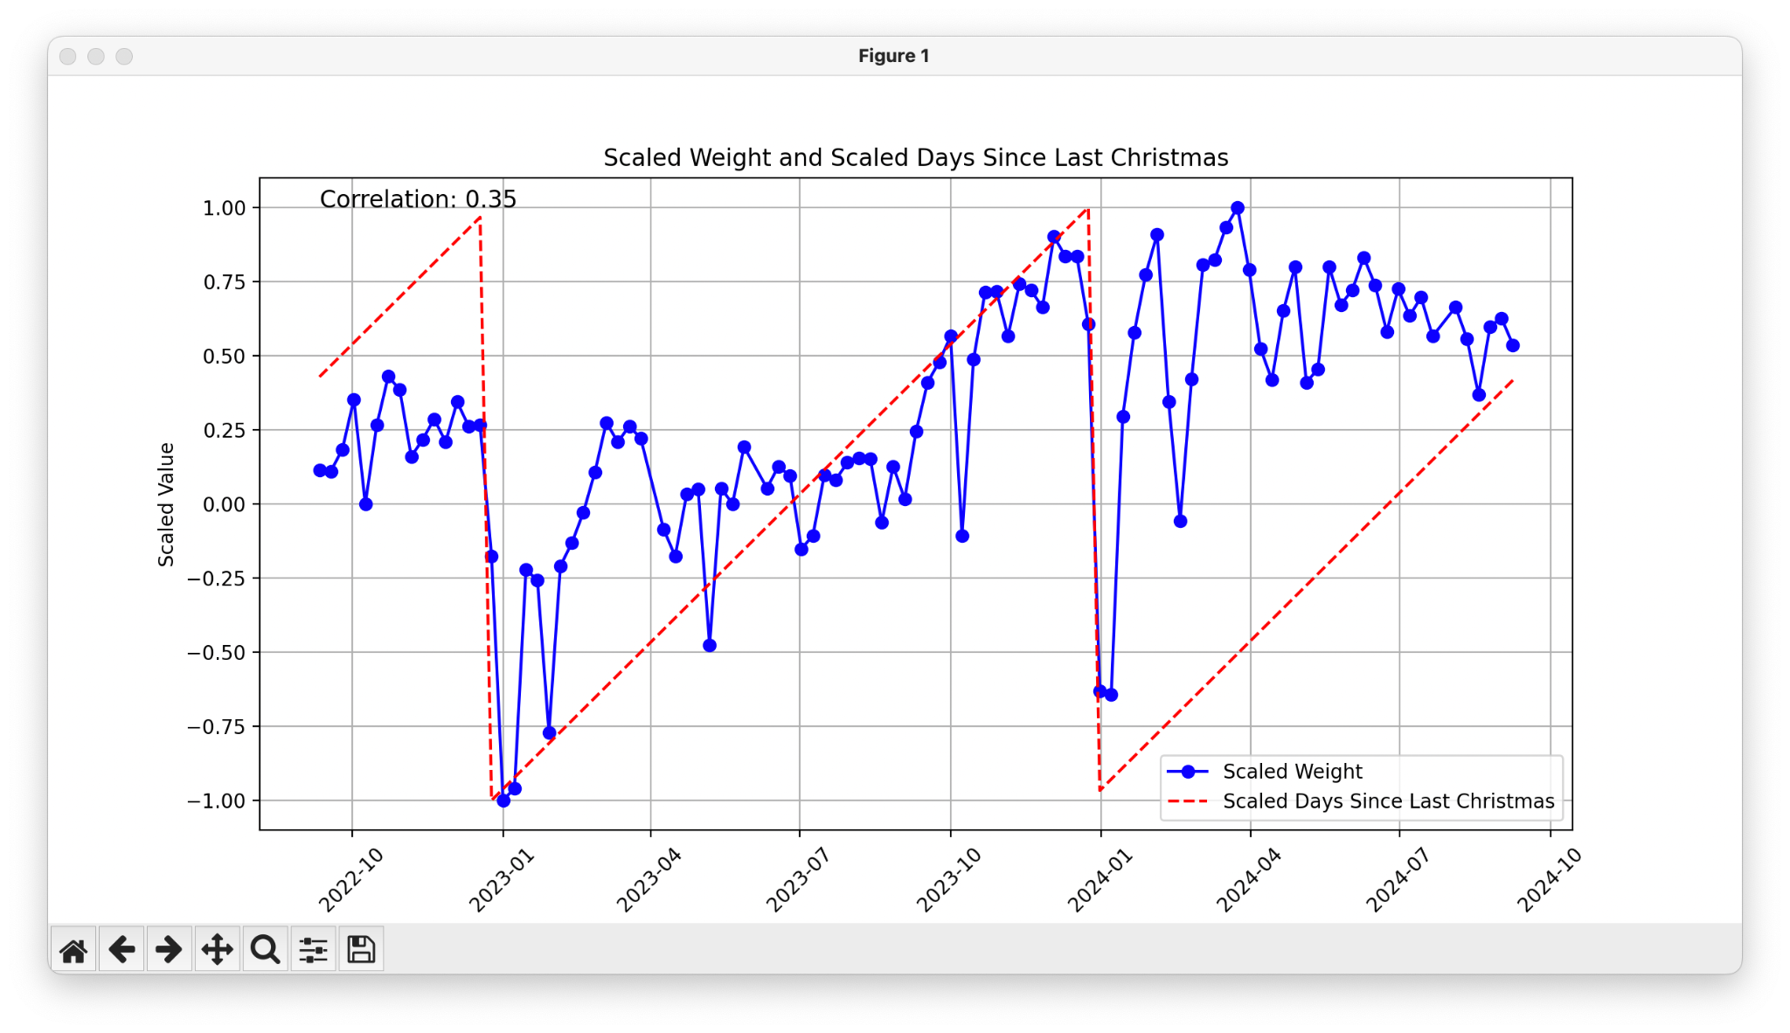
Observation: Weight in peak before Christmas & drop after Christmas
→ Potential feature: how many days to Christmas

Slide 6
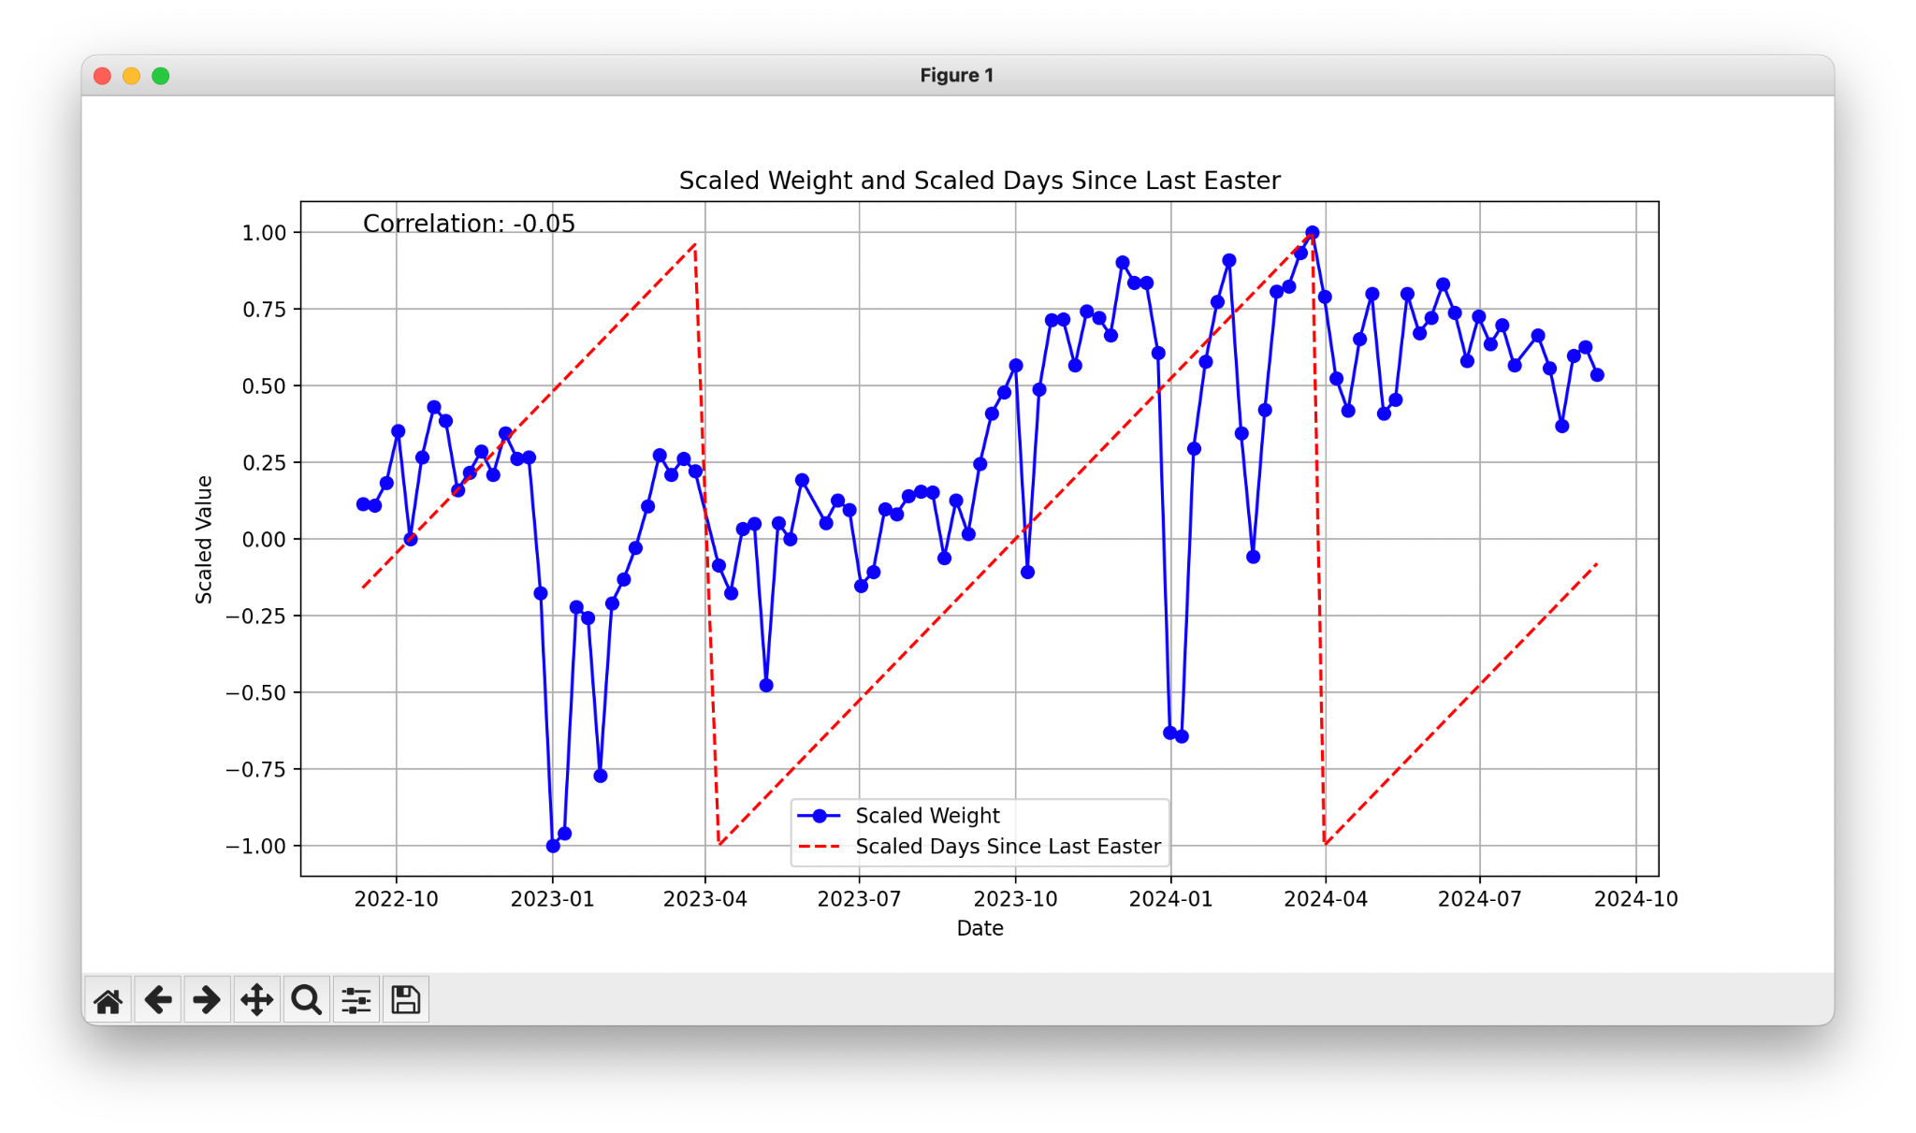
Observation: There is also high demand before Easter and drop after Easter
→ Potential feature: how many days to Easter

Slide 7
Other potential date-related features
Although these values make sense, the correlations are low.
→ Machine Learning model should be non-linear.
How many days to Christmas
How many days to Easter
Day in week
Day in month
Day in year
Week in season
Week in month
Week in year
Month in year
Season in year
Convert to sine/cosine to get rhythm.
(for instance Day in week: Monday (day 1) is near Sunday (Day 7) but value 1 is far from 7.)

Slide 8
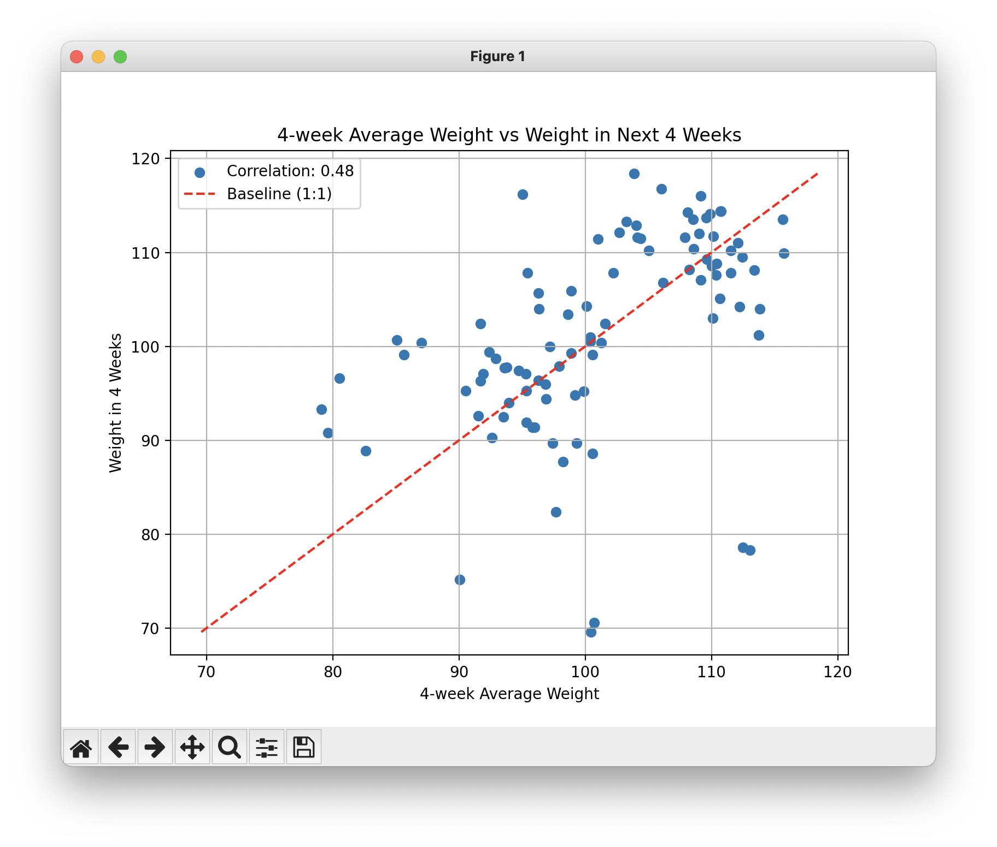
Potential time-series features
Average weight in last 4 weeks
Weights same day in month since last 3 months
Weights same week in year since last 3 years (if enough data)
Etc.
For instance, weight in the next 4 weeks has strong correlation with average weight in the last 4 weeks.
That means, demand in 4 weeks from now tends to increase if demand in the last 4 weeks is high and vice versa.

Slide 9
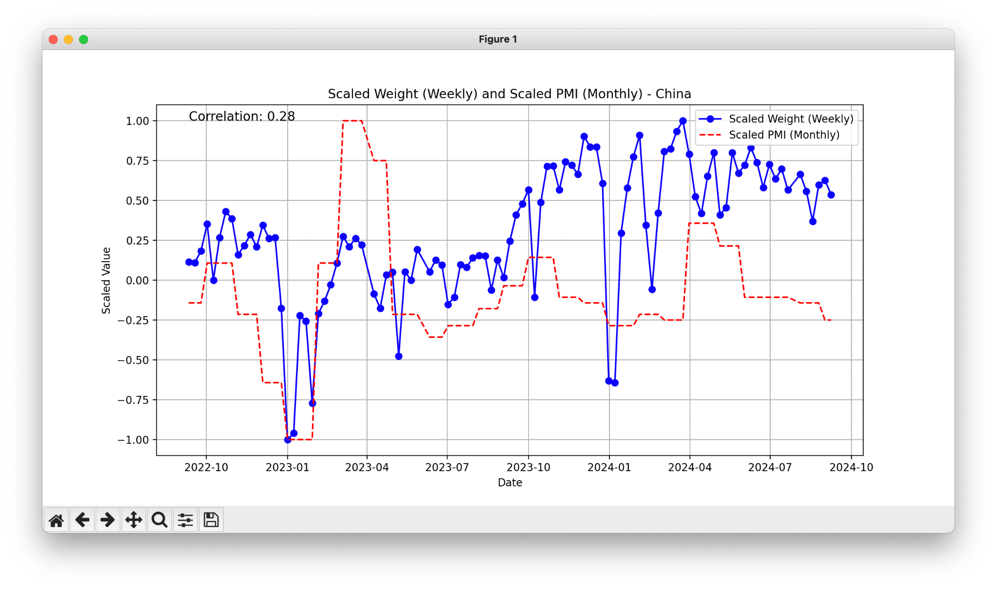
Potential macroeconomic features
PMI
Cargo index
Oil price
PMI of China shows correlation with air cargo demand (for instance, from May-Sep 24), although not very strong.
→ This features can be used with other features as inputs to train machine learning model.

Slide 10
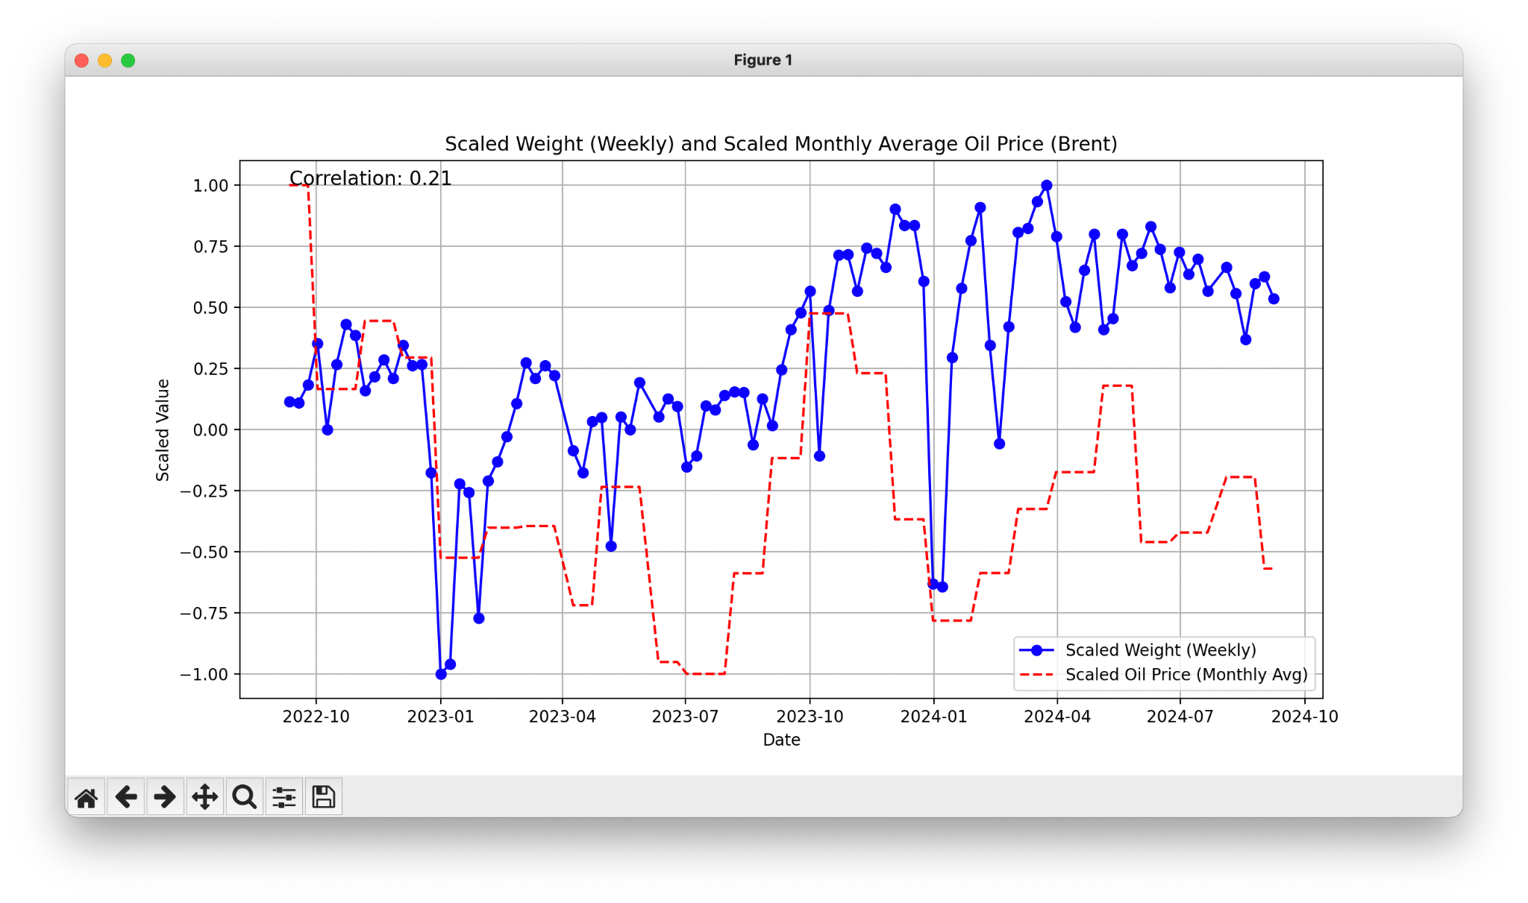
Potential macroeconomic features
PMI
Cargo index
Oil price
Oil price shows non-zero correlation with cargo demand.
Pay attention: high oil price can cause low air cargo demand, but air cargo demand change can also lead to high/low oil price.

Slide 11
Next Steps
Explore CHAMP’s dataset
Build, test, deploy ML model
Continuous literature review
Insight & Prediction:
Demand forecast
Revenue
Long-term price prediction
Focus on CHAMP’s advantage: air waybills
Get more useful features

Slide 12
Appendix & Reference

Slide 13
Current Air Cargo Data-driven solutions
Air cargo recovery problem: https://arxiv.org/pdf/2209.13880
Demand forecasting at the origin-destination (O&D) level: https://arxiv.org/pdf/2407.20192
Air cargo revenue management: https://arxiv.org/pdf/1905.09130
Air cargo long-term price prediction: https://opus4.kobv.de/opus4-whu/frontdoor/index/index/year/2022/docId/899
Air cargo overbooked problem: https://arxiv.org/pdf/1905.09130

Slide 14
Air Cargo + AI companies
CHAMP Cargosystems: https://www.champ.aero/
Flyr: https://flyr.com/
Aerogility: https://www.aerogility.com/
CharterSync: https://chartersync.com/
BlueBox Systems: https://bluebox-systems.com/
CargoAI: https://www.cargoai.co/
Rotate: https://letsrotate.com/
Aircon: https://www.airconai.com/
RTS corp: https://www.rtscorp.com/
Glorious Airport Analytics: https://giairport.com/
World ADC: https://www.worldacd.com/

Slide 15
Contact me
Name: Louis Mai
Email: longmaisg@gmail.com
Linkedin: https://www.linkedin.com/in/tieu-long-mai/

